Slide 1
INSTAGRAM USER ANALYTICS
BY KOMAL PANDITA

Slide 2
PROJECT DESCRIPTION
This project is for an marketing team of an app trying to understand the trends and the user analytics for launching a new marketing campaign
By the data that has been provided we are trying to get the answers to better understand and track the success of the app by user management

Slide 3
Approach
To get the best idea of user engagement we’ll find the most loyal users and most inactive users on the app
For campaign marketing we’ll see the most famous hashtags on the app the photos that has the most likes and the day of the week on which most of the users sign up
For the performance of the app we’ll find the bots and fake accounts on the platform and the inactivity of an user

Slide 4
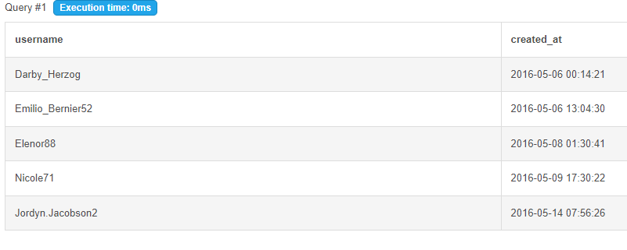
INSIGHTS
1. Most loyal user
These are the people
who were using the platform
for the longest time so
they need to be rewarded

Slide 5
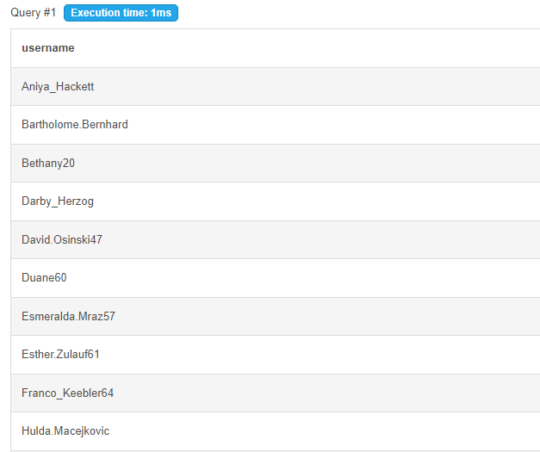
2. INACTIVE USERS
For promotion if the app
and more user engagement
we can send the promotional
emails to these inactive users

Slide 6
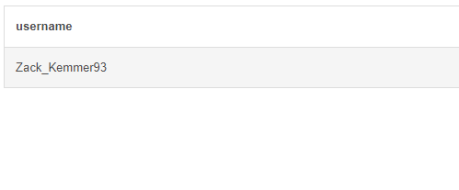
3. CONTEST WINNER
Winner of the contest of most liked picture on the app

Slide 7
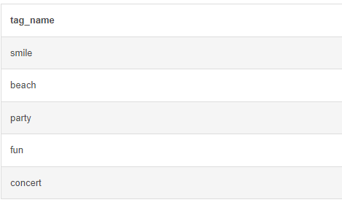
4. MOST FAMOUS HASHTAGS
For the brand reach on the app these were most famous hastags used on the app

Slide 8
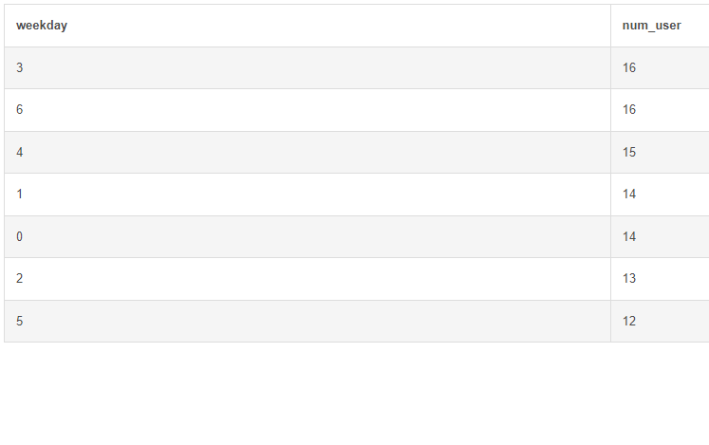
5. Launching AD Campaigns
Thursday and Sundays are the best days to launch the ads on the platform

Slide 9
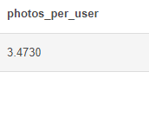
- USER ENGAGEMENT
This is the ratio of photos per user

Slide 10
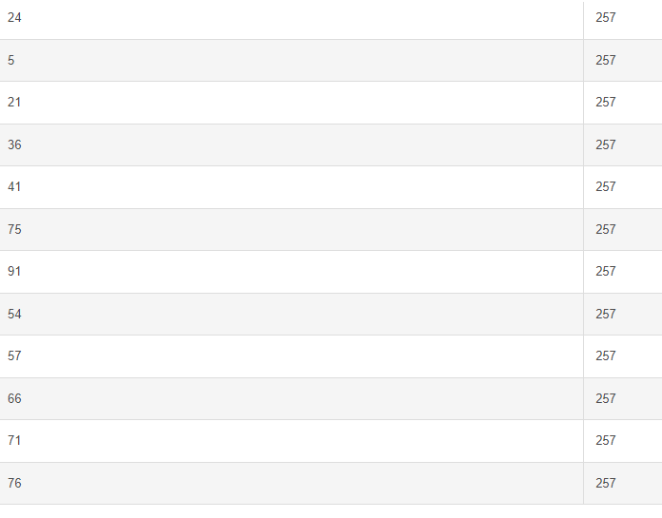
- BOTS & FAKE ACCOUNTS
These are the user Ids for all the bots/fake accounts on the app

Slide 11
RESULTS
Need to reward our most loyal users
After finding the inactive users we can send the promotional emails to them
More and more contests needs to be give on the app for user engagement and winners should be rewarded
From launching ads we can use the most famous hastags on the app and launch the campaign on Thursday’s and Sunday’s
Bots and fake accounts are needed to be blocked from the app

